Slide 1


Capstone #2, Supervised Learning
By Trevor Barrow

Slide 2
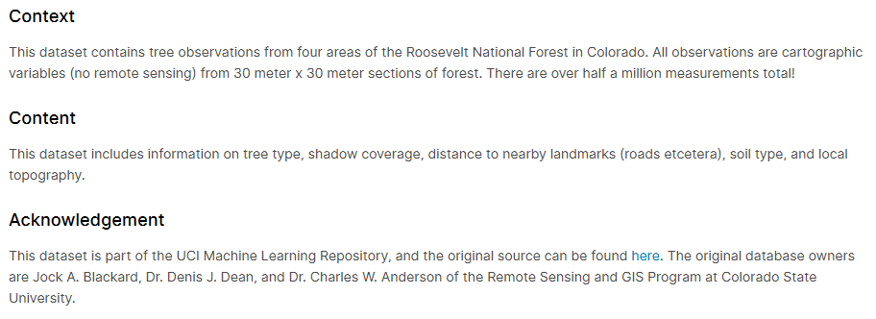
Context & Content of Dataset
Source: https://www.kaggle.com/uciml/forest-cover-type-dataset

Slide 3
Variables
Target Variable
Cover Type:
1 - Spruce/Fir 2 - Lodgepole Pine 3 - Ponderosa Pine 4 - Cottonwood/Willow 5 - Aspen 6 - Douglas-fir 7 - Krummholz
Explanatory Variables
Elevation - Elevation in meters Aspect - Aspect in degrees azimuth Slope - Slope in degrees Horizontal_Distance_To_Hydrology - Horz Dist to nearest surface water features Vertical_Distance_To_Hydrology - Vert Dist to nearest surface water features Horizontal_Distance_To_Roadways - Horz Dist to nearest roadway Hillshade_9am (0 to 255 index) - Hillshade index at 9am, summer solstice Hillshade_Noon (0 to 255 index) - Hillshade index at noon, summer solstice Hillshade_3pm (0 to 255 index) - Hillshade index at 3pm, summer solstice Horizontal_Distance_To_Fire_Points - Horz Dist to nearest wildfire ignition points Wilderness_Area (4 binary columns, 0 = absence or 1 = presence) - Wilderness area designation Soil_Type (40 binary columns, 0 = absence or 1 = presence) - Soil Type designation
Source: https://www.kaggle.com/c/forest-cover-type-prediction/data

Slide 4
Research Question
Original Influence: While all the features are integers, not all of them are continuous variables. Soil_Type and Area are actually categorical variables, yet their sizes greatly vary. While Soil_Type is made up of forty different values, Area is made up only of four. Perhaps these size differences could influence the level of bias and inaccuracy in our models.
Question: How much do the inclusion of categorical variables and their sizes influence the level of accuracy of our models, and in what way do they influence them?

Slide 5
Model Selection: Considerations
Majority of features are continuous
Only two features are categorical
Target variable is integer-composed but categorical
Target variable likely corresponds to ranges of integer features as opposed to particular values
Features cannot be added up to equate to a target variable
Need classification
Thus, Decision Trees and Random Forests will be used.

Slide 6
Reasons For Using These Models
Decision Tree
Random Forest
Easy to represent the model visually
Can handle varied types of data
Feature selection is a part of the model
Easy to use with little data preparation
Viable for both regression and classification
Tends to be a top performer with low variance and high accuracy
Can handle varied types of data
Feature selection is part of the model
Easy to use with little data preparation
Viable for both regression and classification

Slide 7
Weaknesses of These Models
Decision Tree
Random Forest
Inherent randomness in generation leads to variance in estimates
Not built the same way for same data each time
Incredibly prone to overfitting if too deep or complex
Biased towards dominant class
Requires balanced data
In both classification and regression, will not predict outside of sample
Can become very large and slow if they grow too wildly
Lack of transparency/insight in process, known as a ‘black box’ model

Slide 8
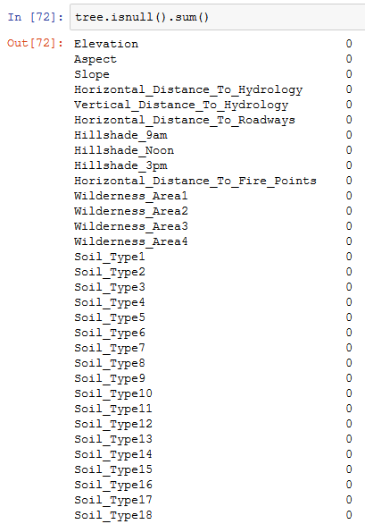
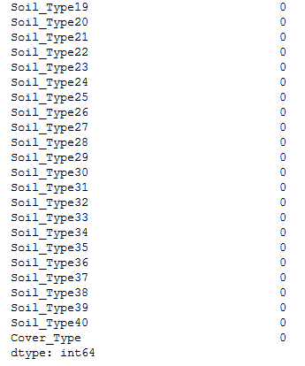
Data Cleaning: Checking for Nulls

Slide 9
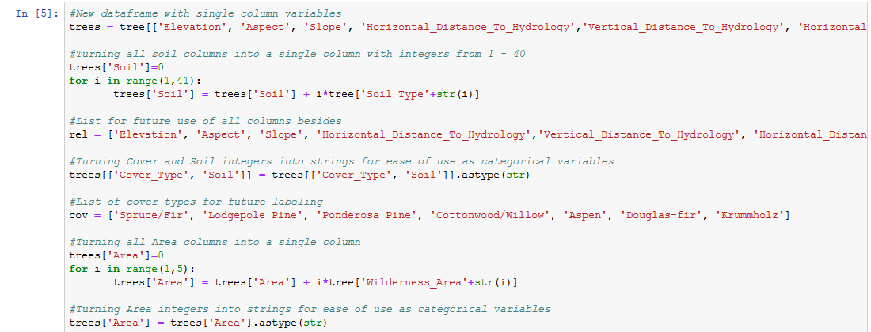
Data Cleaning: Too Many Columns

Slide 10
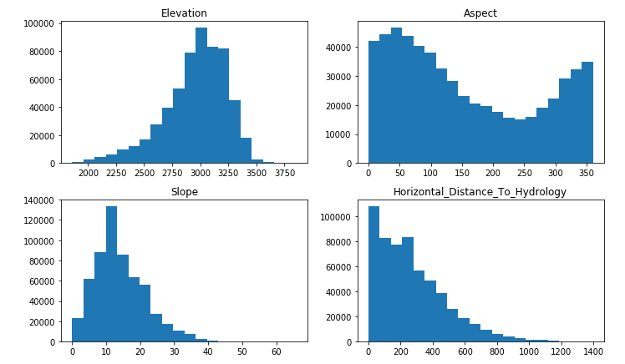
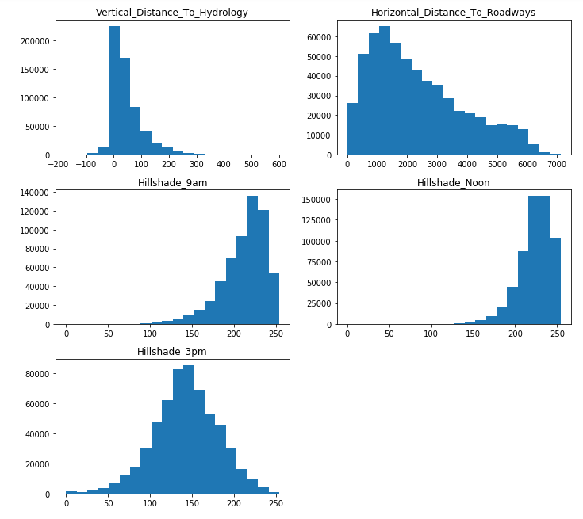
Data Exploration: Distributions

Slide 11
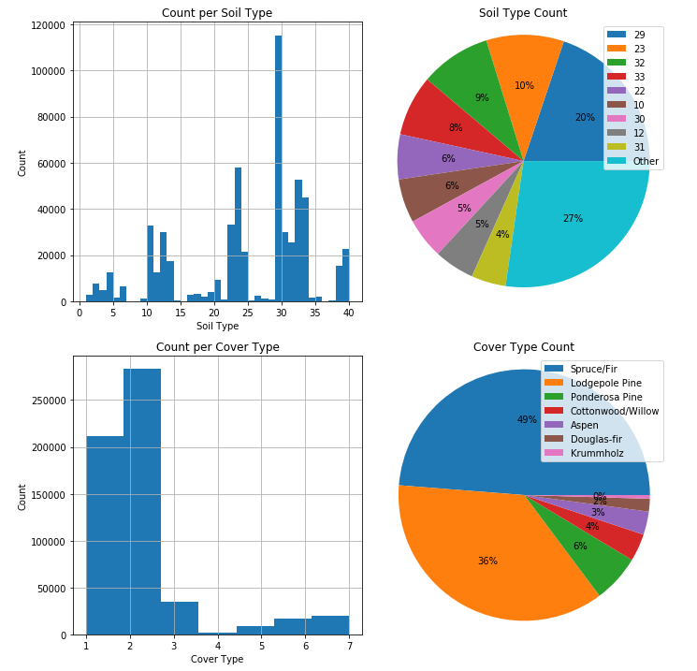
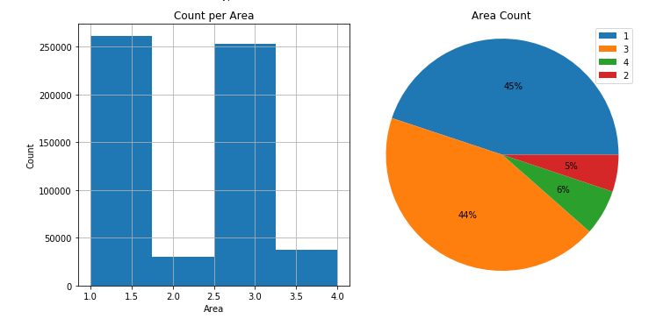
Data Exploration: Soil, Cover, and Areas

Slide 12
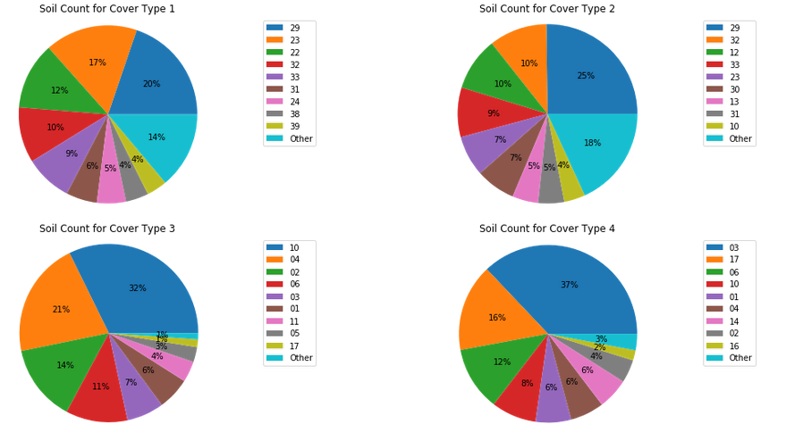
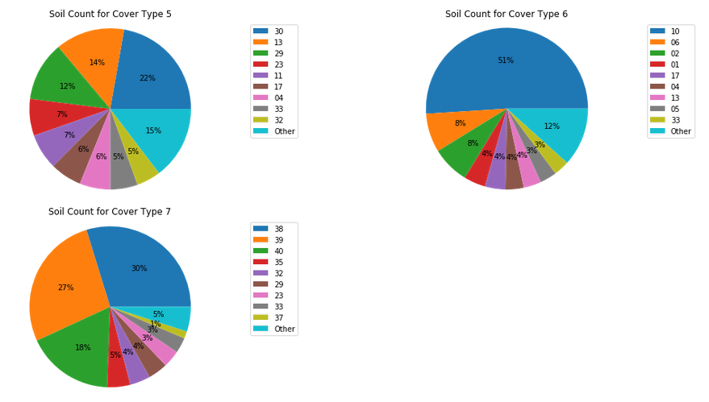
Data Exploration: Soil Count per Cover Type

Slide 13
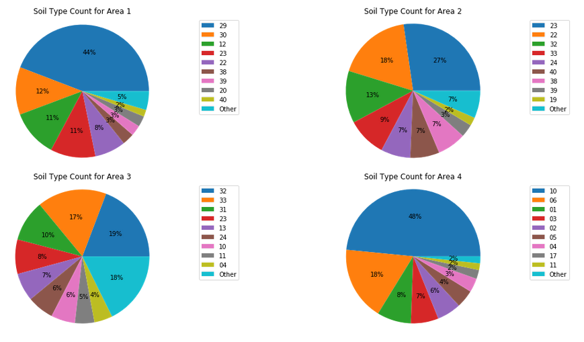
Data Exploration: Soil Count per Area

Slide 14
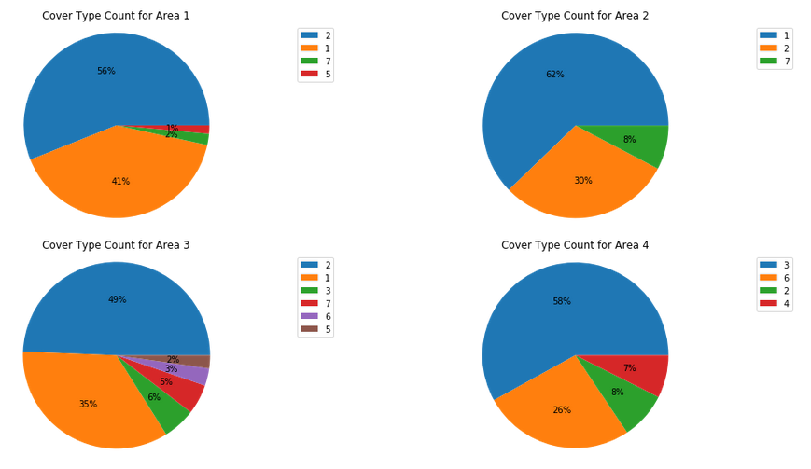
Data Exploration: Cover Count per Area

Slide 15
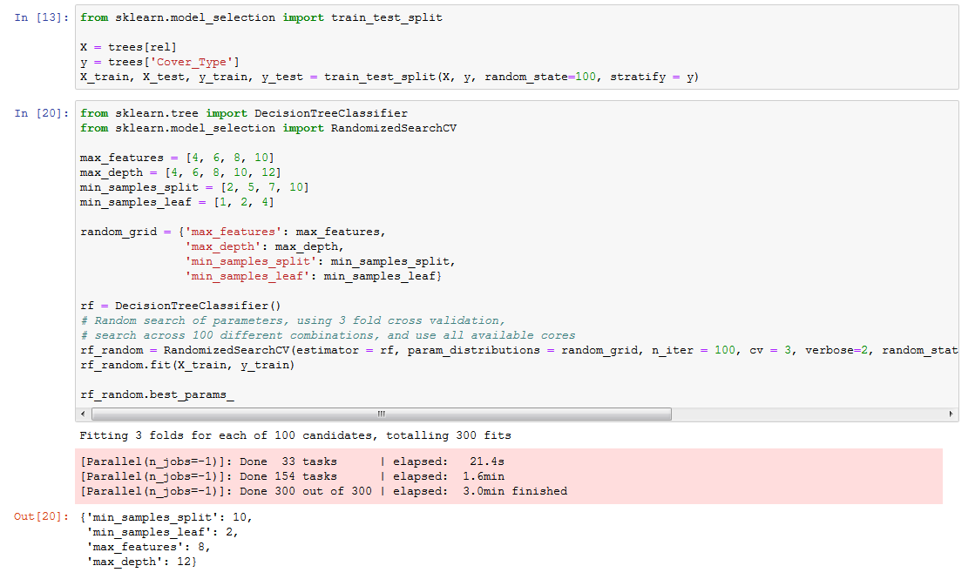
Hyperparameter Tuning

Slide 16
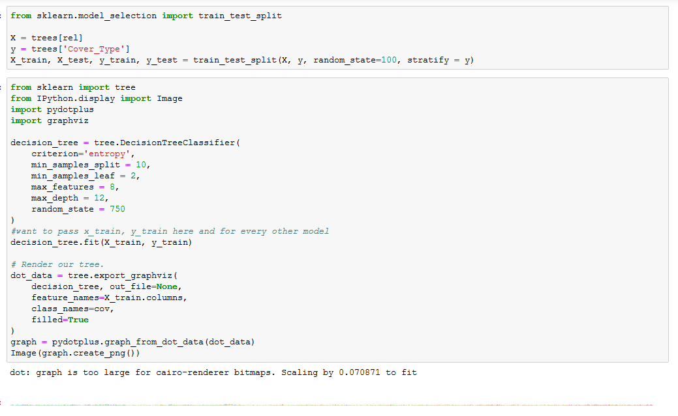
Decision Tree Example

Slide 17
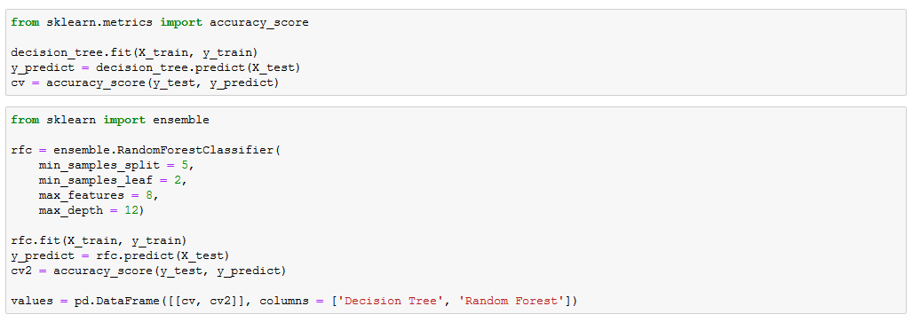
Decision Tree + Random Forest Example

Slide 18
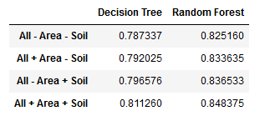
Model Accuracy Scores

Slide 19
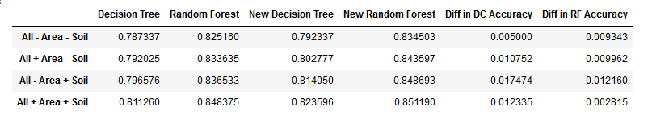
Model Accuracy Scores w/ Only Areas 1 & 3

Slide 20
Generalized Results & Outcomes
The larger the dataset, the better (obviously)
Categorical variables with a small amount of values are useful in classification
Categorical variables with a much larger (10x) amount of values are even more helpful if it much, much smaller than the dataset size
Neither alone
Having both is even better
Removal of information tied to much smaller categorical values does not always justify possible increases in efficiency

